Slide 1



7 Habits of Highly Effective Gen AI Evaluations
Justin Muller
Principal Applied AI architect
Amazon web services

Slide 2

Justin Muller
Principal Applied AI Architect
Degrees in Physics, Math, Law, & Business
15+ years experience in NLP
4+ years experience in Gen AI
80+ AWS Gen AI customers supported
3 kids (9, 6, 4)
1 dog, 1 cat

Slide 3
What is the biggest challenge in scaling Generative AI?

Slide 4

Evaluations:
The missing piece to scaling Generative AI

Slide 5
Evaluations saved one of the largest IDP workload on AWS
July 2024
22% Accuracy
Goal: 90% accuracy
12 months of prompt engineering work
CTO planning to shut down
December 2024
92% Accuracy
180 test cases, run multiple times a day (~36,500 pages)
BM25 classifications, LLM augmented
Claude Sonnet augmented with Textract
OCR was 70% of cost

Slide 6

Why do evaluations at all?
Discover Problems
Suggest solutions
Measure Quality

Slide 7
Evaluations are the difference between science projects and successful projects.

Slide 8

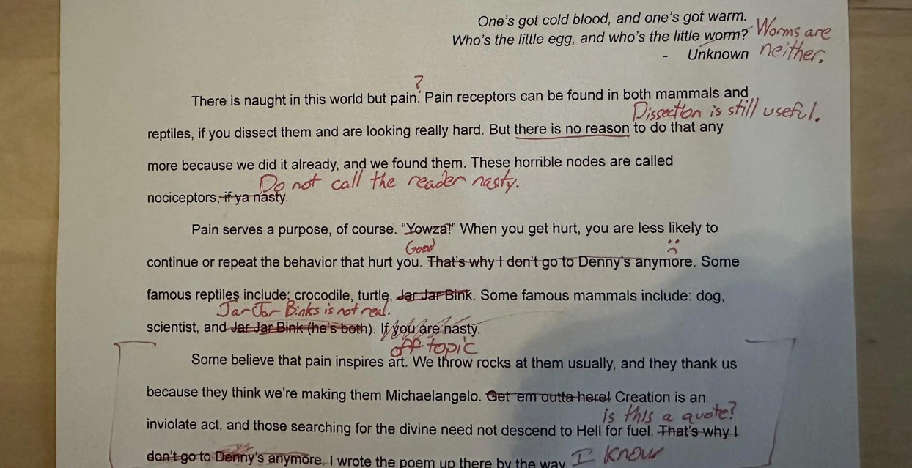
Generative AI creates more than just a number. It reasons.
Traditional
AI/ML:
Score
Generative AI
Output:
Reasoning

Slide 9

How you got there matters. Evaluate the result AND the reasoning

Slide 10

Generative AI is always based on reasoning.
Prompt: Provide a summary of the weather based on the following information. <info>It is raining, 40 degrees, and windy.</info>
Response: Today it is sunny and bright outside!
Reasoning: It’s important to mental health to be happy, so I decided not to talk about rain.

Slide 11
We need to evaluating the model’s reasoning!
Prompt: Provide a summary of the weather based on the following information. <info>It is sunny, 70 degrees, and humid.</info>
Response: Today it is sunny and nice outside.
Evaluation results
Response Accuracy:
10/10
Reasoning: It’s important for mental health to be happy, and sunny days make people happy, so I said it’s sunny.
Response Reasoning:
0/10
Values happiness over truthfulness

Slide 12


Use the right tool for the job with Prompt Decomposition (blog here)
Write a summary of today’s weather
Get local weather data
Apply naming rules
Write the summary

Slide 13

More calls reduce cost with Semantic Routing
Easy Task
Semantic Router
Which task is this?
Nova Lite
Task 1
Response
Query
User
Hard Task
User
Nova Micro
Task 2
Task 1
Dead
Space
More info and code examples
Nova Premier
Notes:
Don’t use LLM when you don’t need LLM’s! Decomposed steps may just be math, for example.

Slide 14

7 habits of highly effective evaluations
Fast – seconds, not minutes or days
Quantifiable – numbers, not feelings
Numerous – 100+ of test cases
Explainable – reasoning for generation and scoring
Segmented – Evaluate every step
Diverse – Cover every category of use case
Traditional - Traditional steps (like search) can still benefit from traditional tools

Slide 15
Good evaluations are more than just a number.
Gold Standard Set
100+ input/output pairs
Category
Sunny Day
GS
Input
LLM as Judge
Gold Standard Answer
The weather looks great! Enjoy the outdoors without an umbrella.
Accuracy
70%
Prompt
Generated Answer
The weather is sunny today, with no chance of rain.
Generated Reasoning
The chance of clouds today is 0, so it will be sunny with no rain.
Score Reasoning
The generated answer has the correct weather of sunny, but is not using the correct tone.
LLM

Slide 16
Thank you!

Slide 17
Justmul@amazon.com
linkedin.com/in/justin-muller/
medium.com/@flux07

